Slide 1

cares
Community App Responding to Emergency Situation

Slide 2

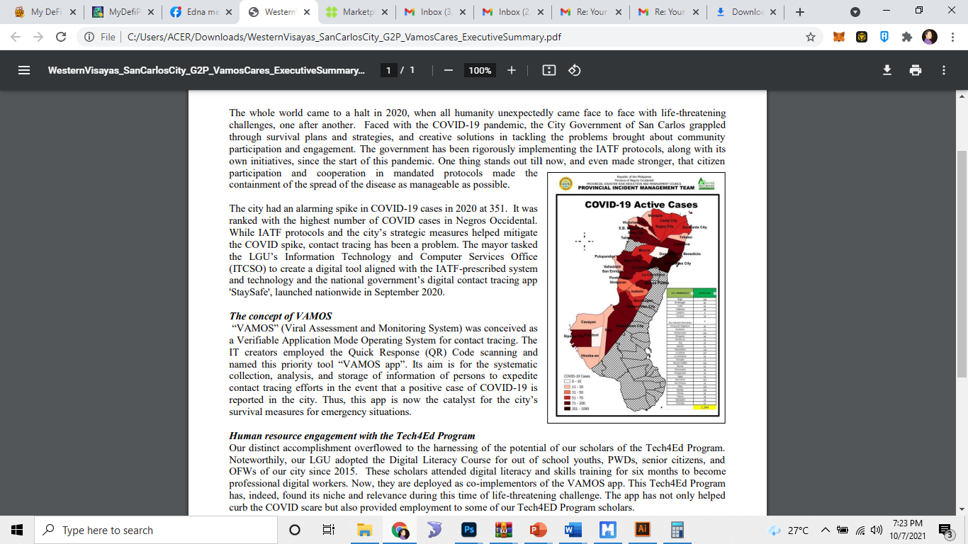

SAN CARLOS CITY:
ranked with the highest number of COVID cases in Negros Occidental in 2020
It had an alarming spike in COVID-19 cases reaching 351 in one day

Slide 3
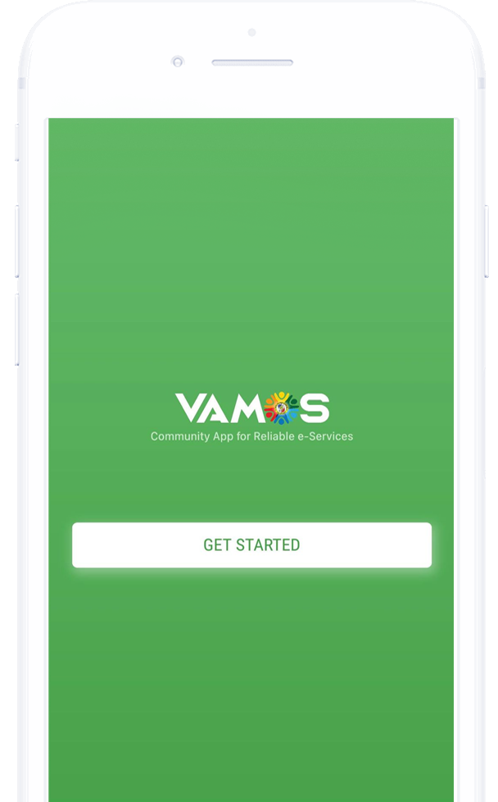
THE CONCEPT
“VAMOS” – (Viral Assessment and Monitoring System) MOBILE App
the official contact tracing mobile application of San Carlos City, Negros Occidental, Philippines and the catalyst for the city’s survival measures for emergency situations.
conceived as a Verifiable Application Mode Operating System for contact tracing employing the Quick Response (QR) Code scanning.
It aims for the systematic collection, analysis, and storage of information of persons to expedite contact tracing efforts in the event that a positive case of COVID-19 is reported in the city.
It is designed to register entities, such as individual, juridical and transportation, for the monitoring of their activities for easier and faster contact tracing.

Slide 4
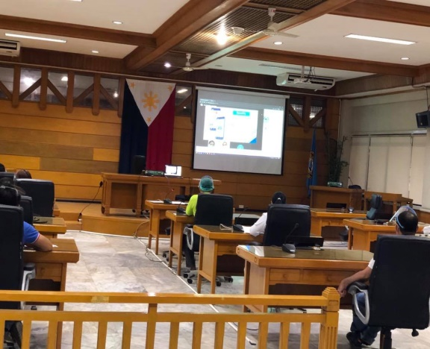
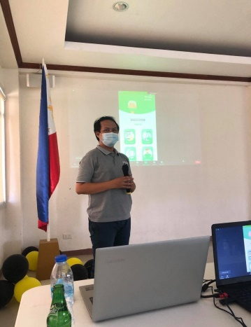
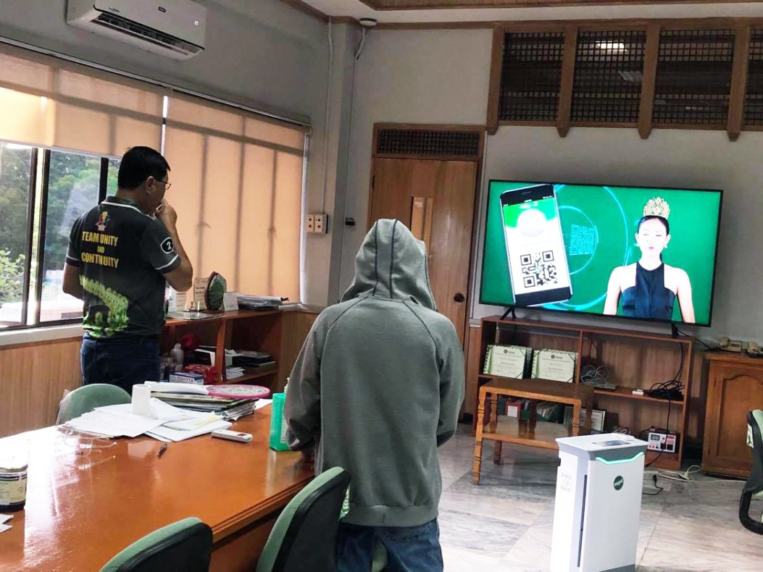
Launching of the Mobile App
Presentation to Various Stakeholders
Presentation of VAMOS Infommercial to the LCE

Slide 5

ADOPTION OF THE TECHNOLOGY

Slide 6
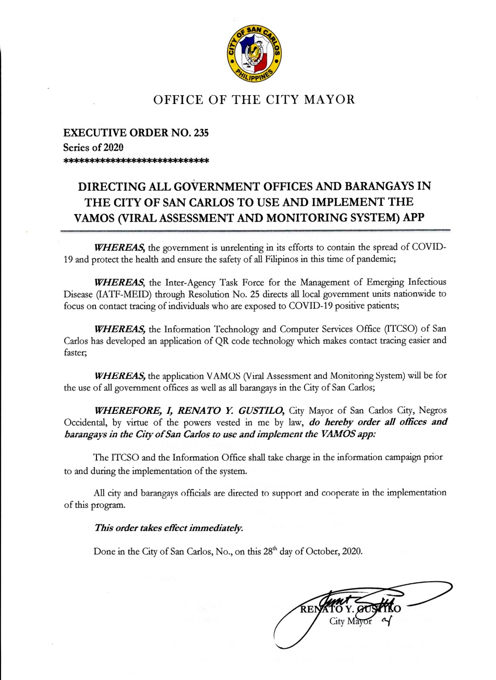
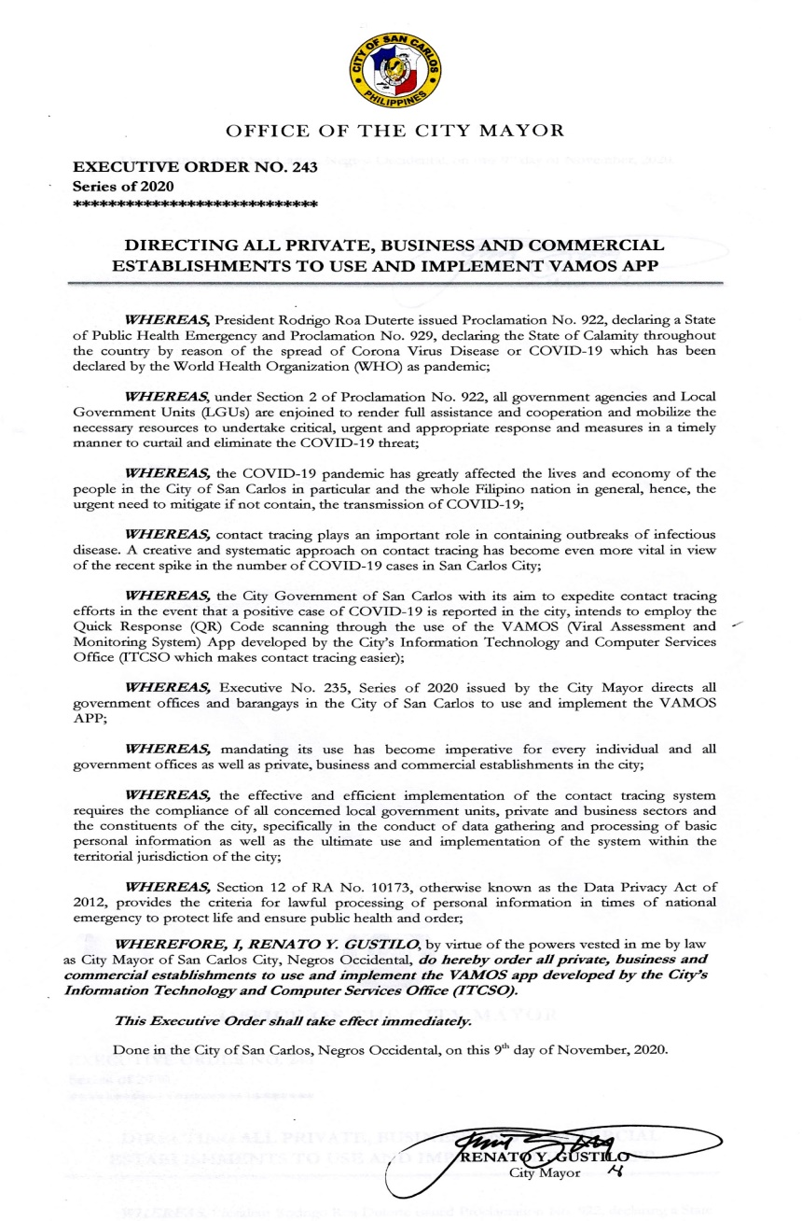
Policy Formulation
Executive No. 235, Series of 2020
“Directing all Government Offices
and Barangays in the City of San Carlos
to Use and Implement VAMOS”App”
Executive No. 243, Series of 2020
“Directing all Private Business and
Commercial Establishments to Use
And Implement the VAMOS App”

Slide 7
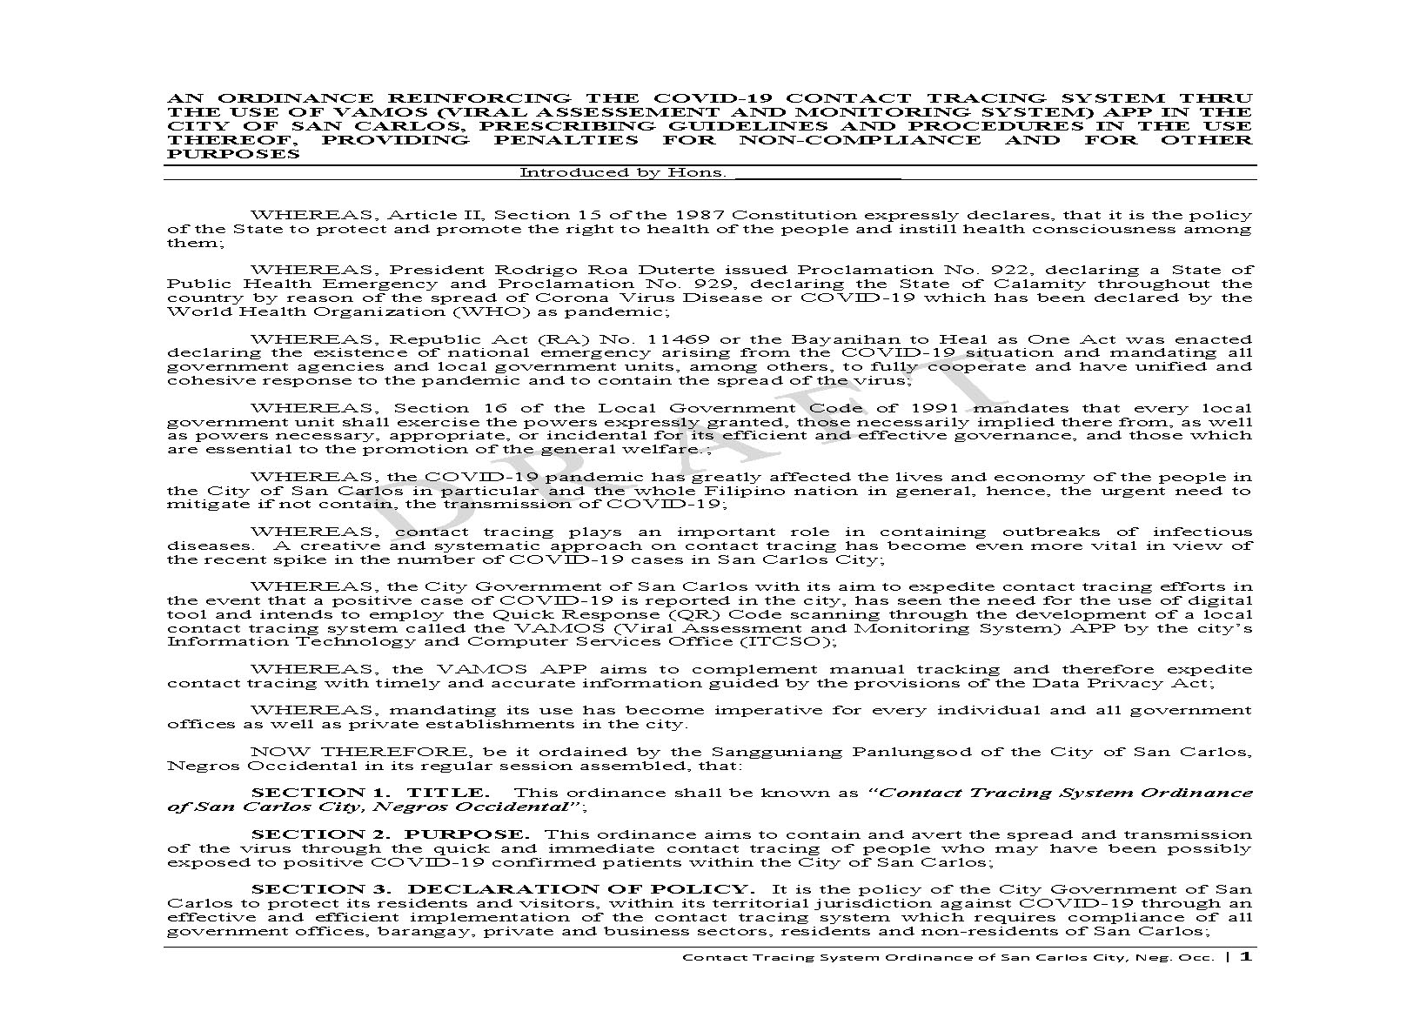
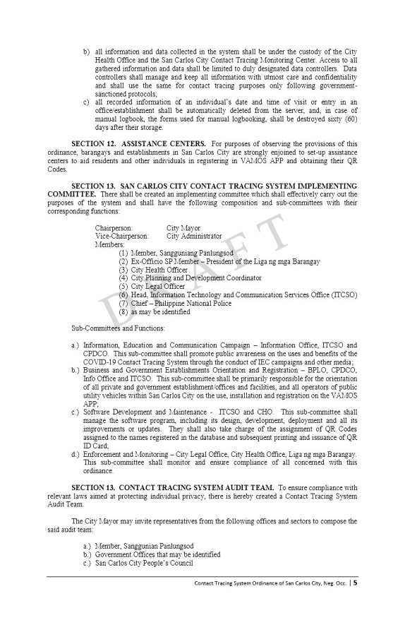
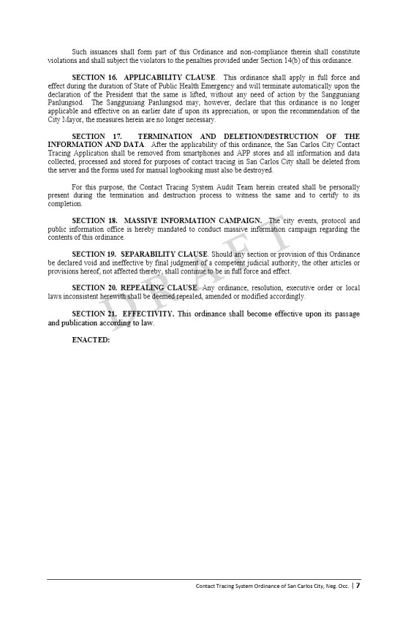

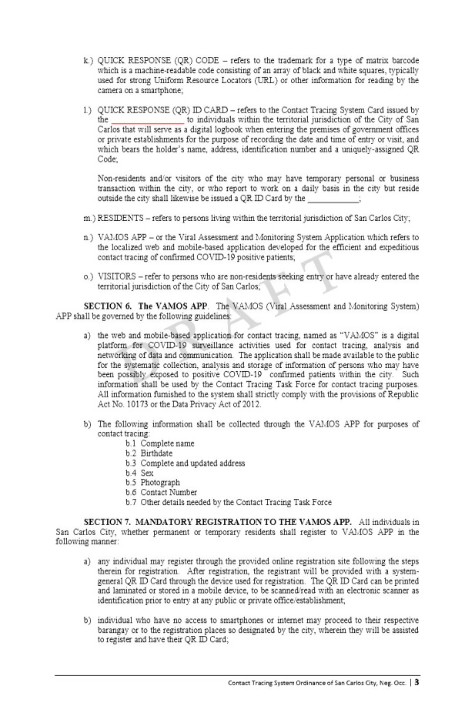
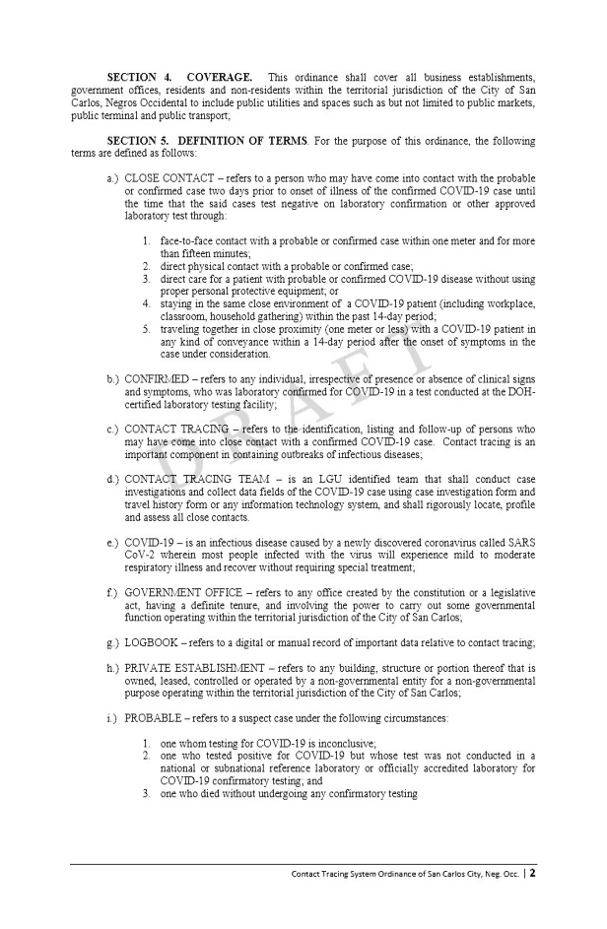
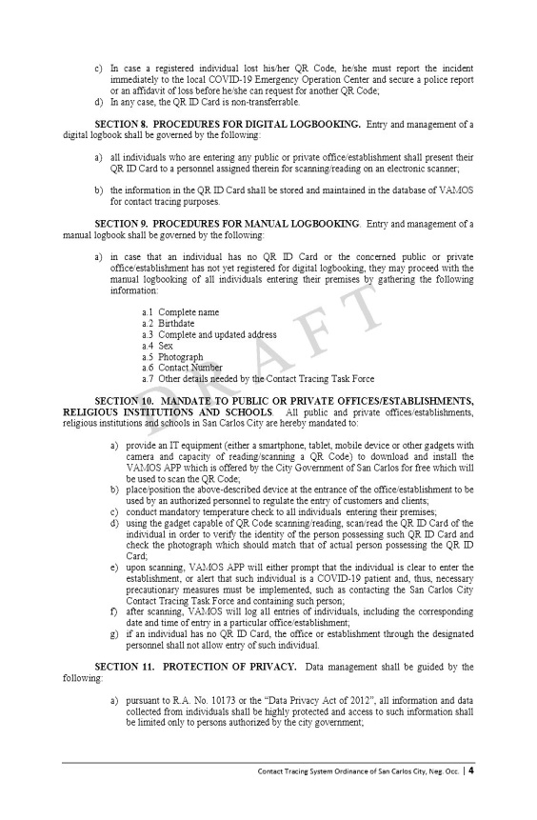
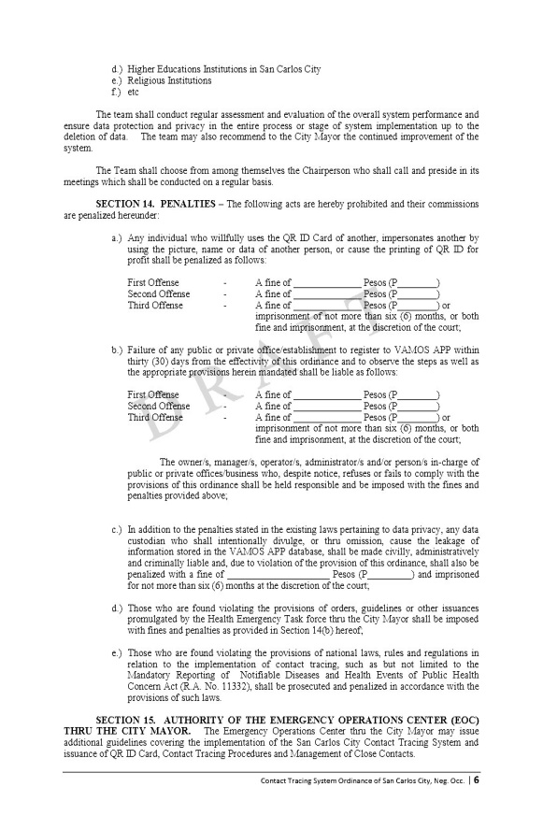
Policy Formulation
The VAMOS Community App Ordinance

Slide 8
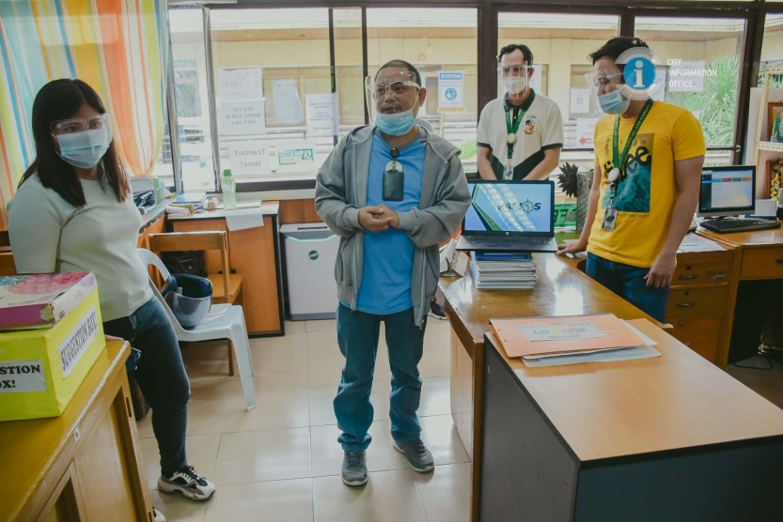
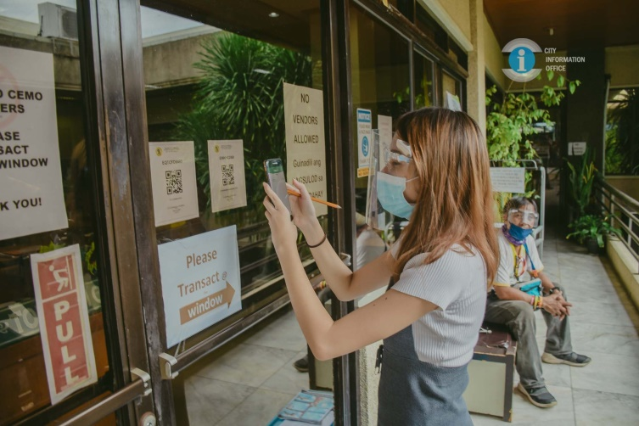
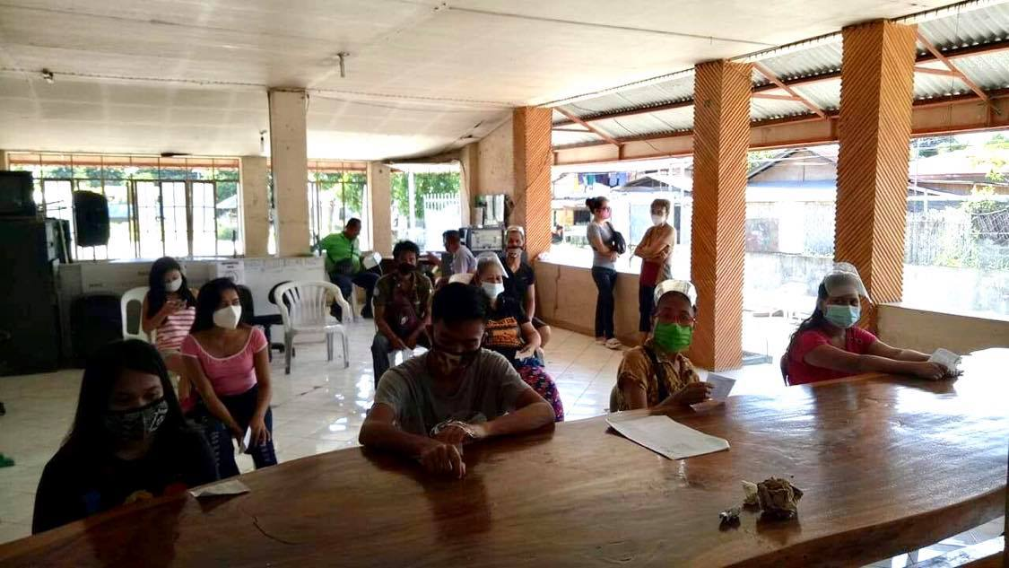

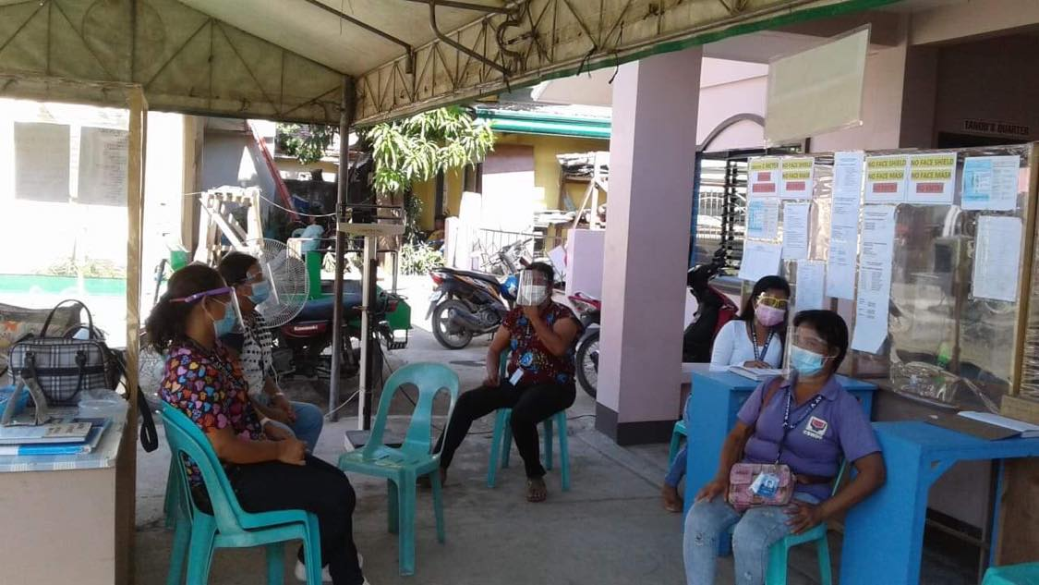
Technology Dissemination / Citizen participation
Dissemination drive to all government offices, barangays and all business establishments for compliance
Meeting/orientation at the barangay level for registration
A week-long online meeting via Zoom with various juridical entities such as businesses, schools, and other institutions
Tech4ed centers in 18 barangays utilized as registration sites, tech4ed graduates manning the system

Slide 9
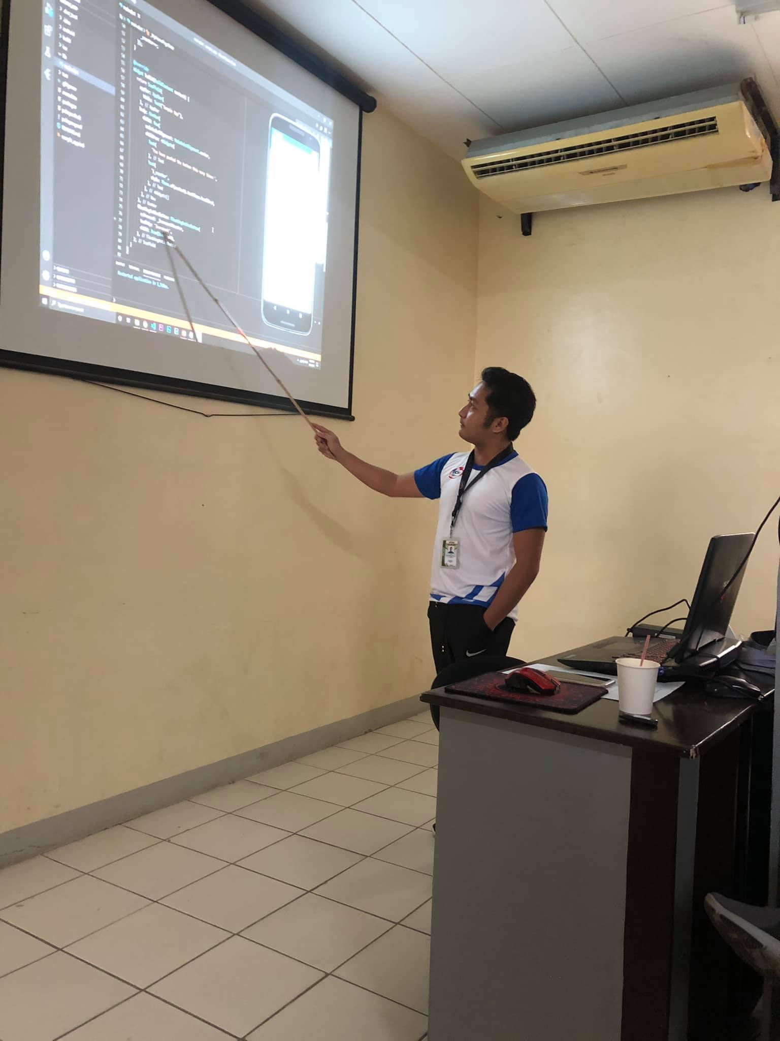
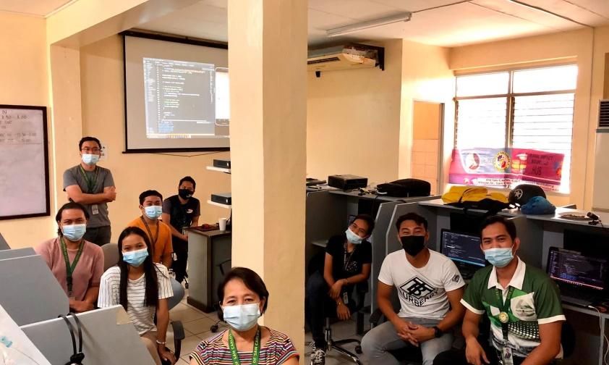

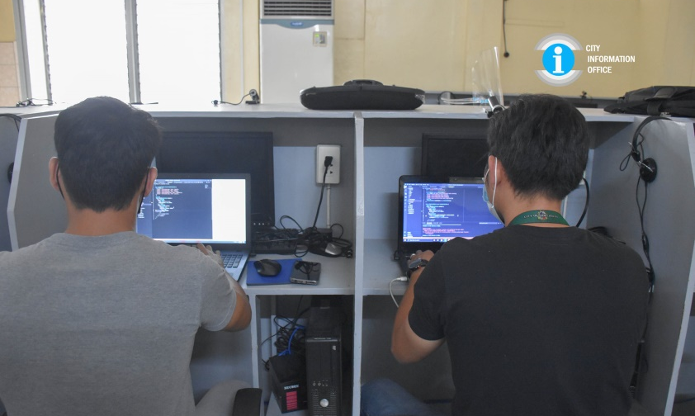
Human resource/ Implementors of the Project
Human Resource /
Implementors of
The Project
Information Technology and Computer Services Office (ITCSO) Personnel

Slide 10
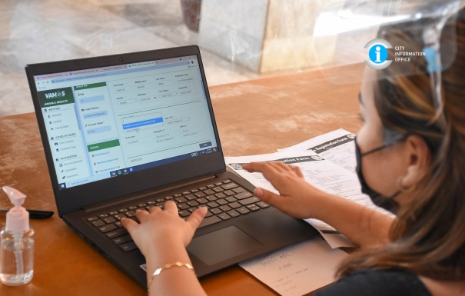
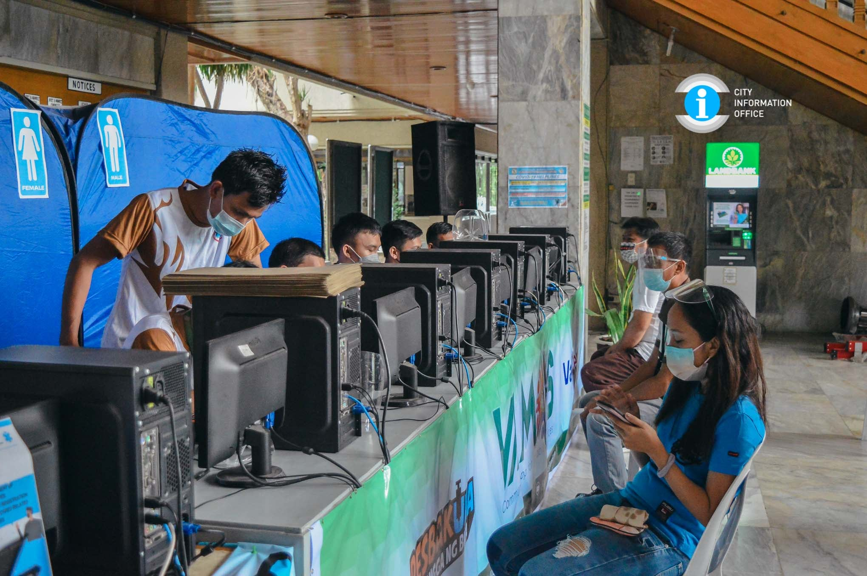

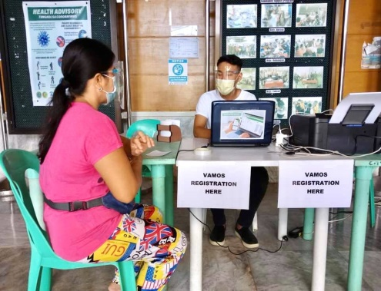
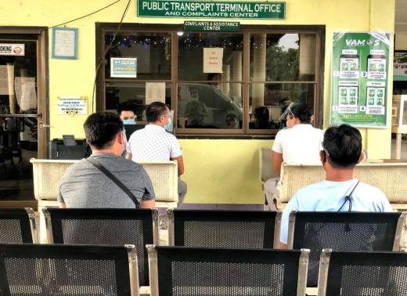
Human resource/ Implementors of the Project
Human Resource /
Implementors of
The Project
Tech4ED Program Personnel and Graduates as Registrants

Slide 11
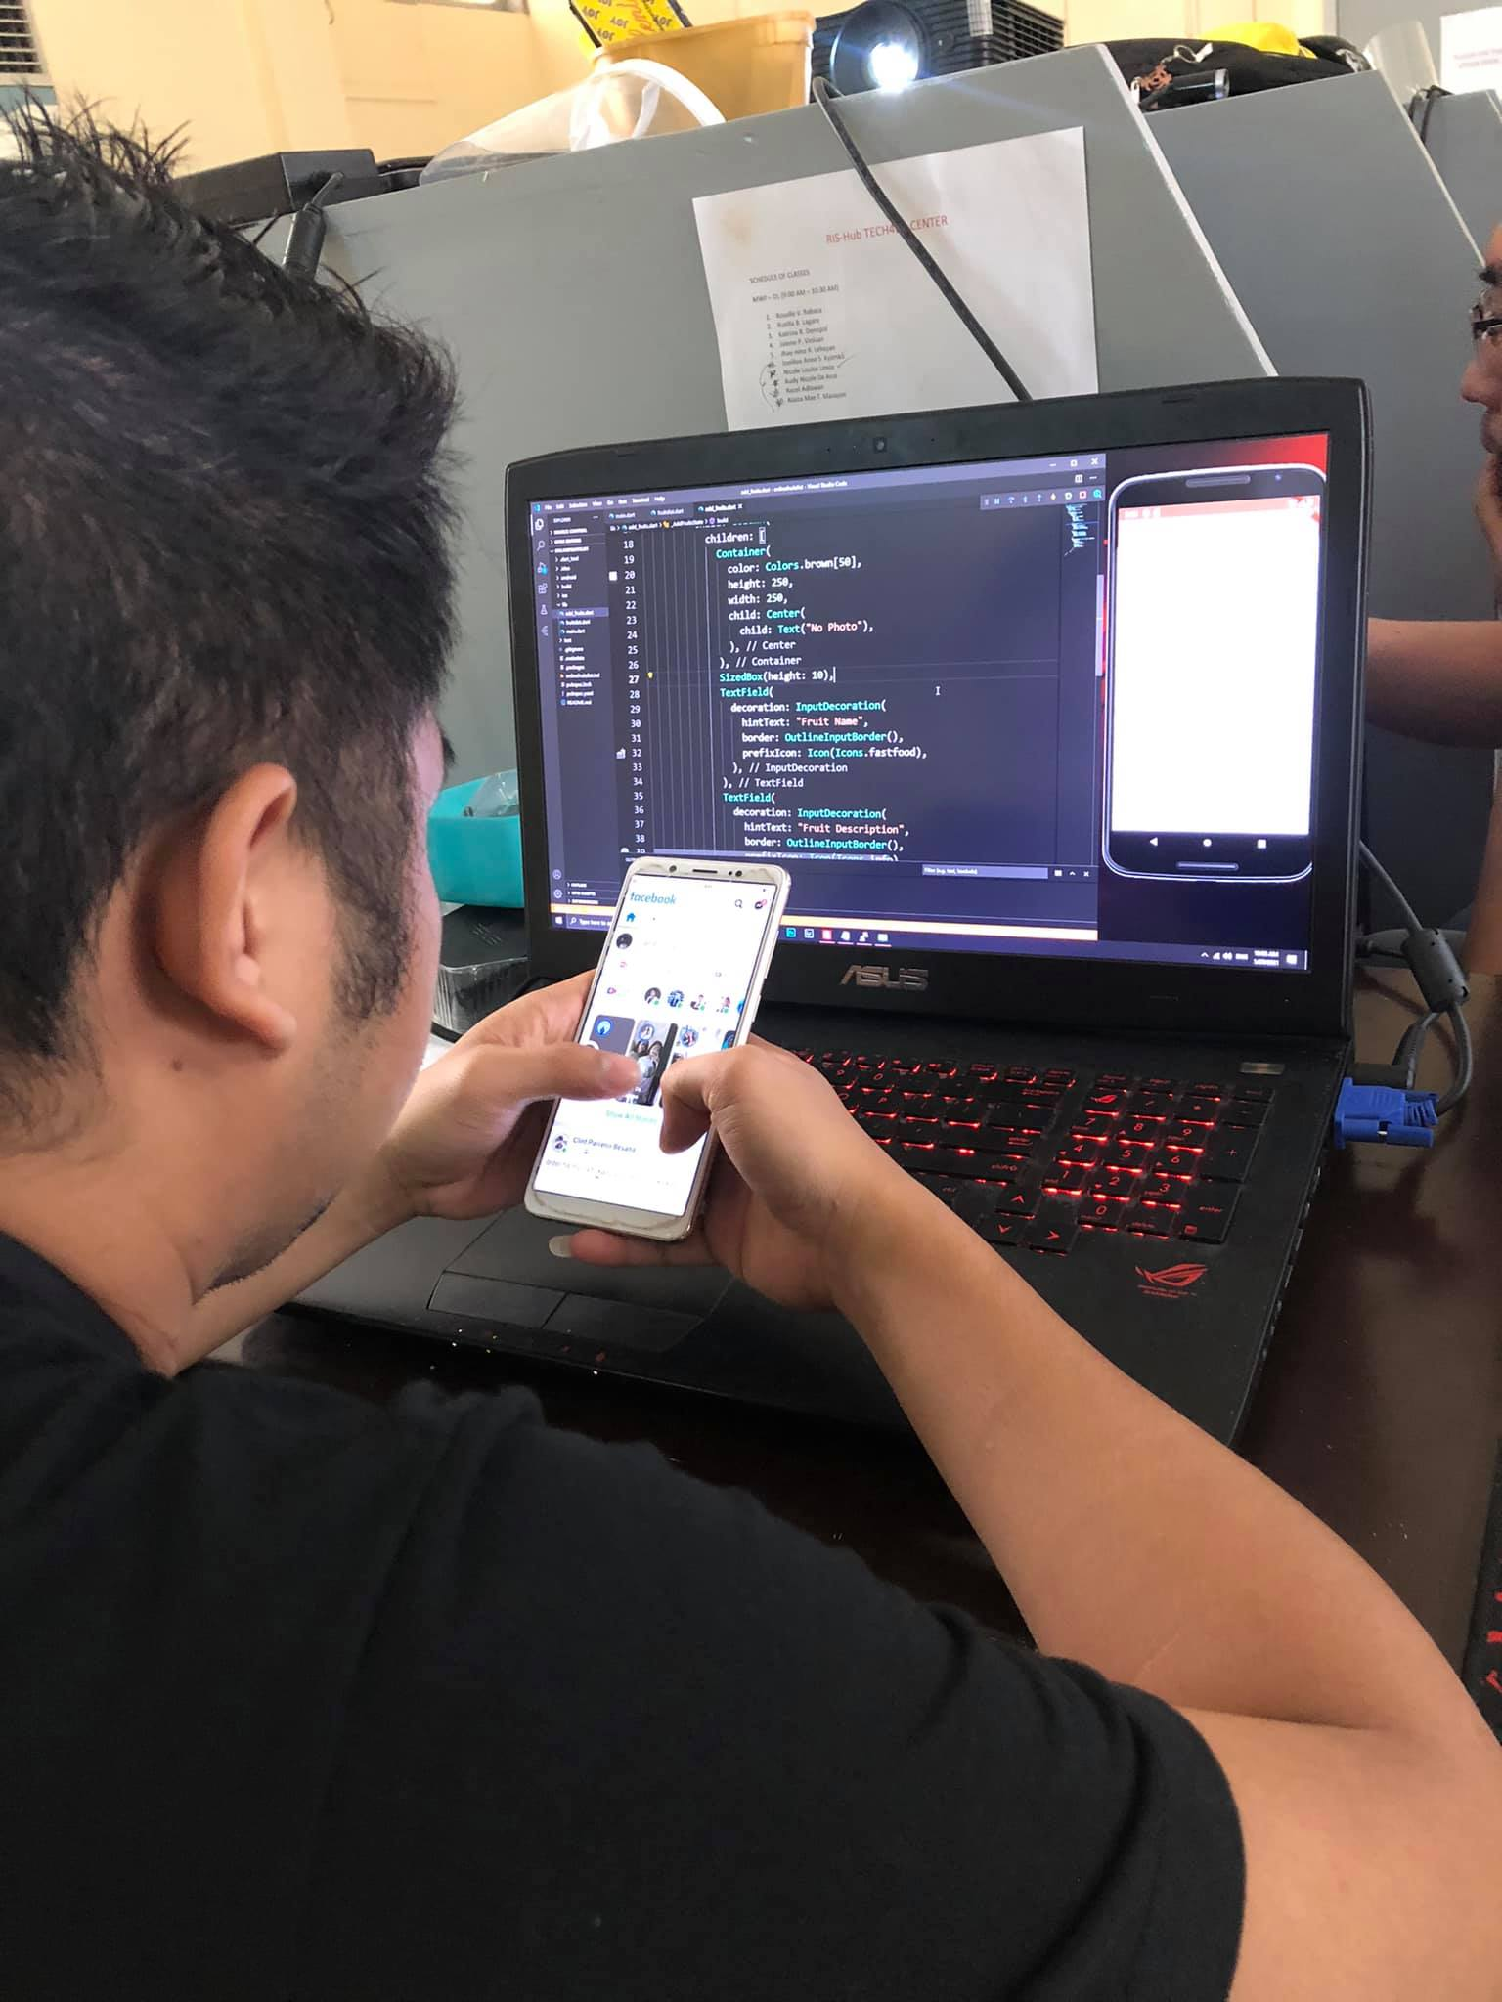
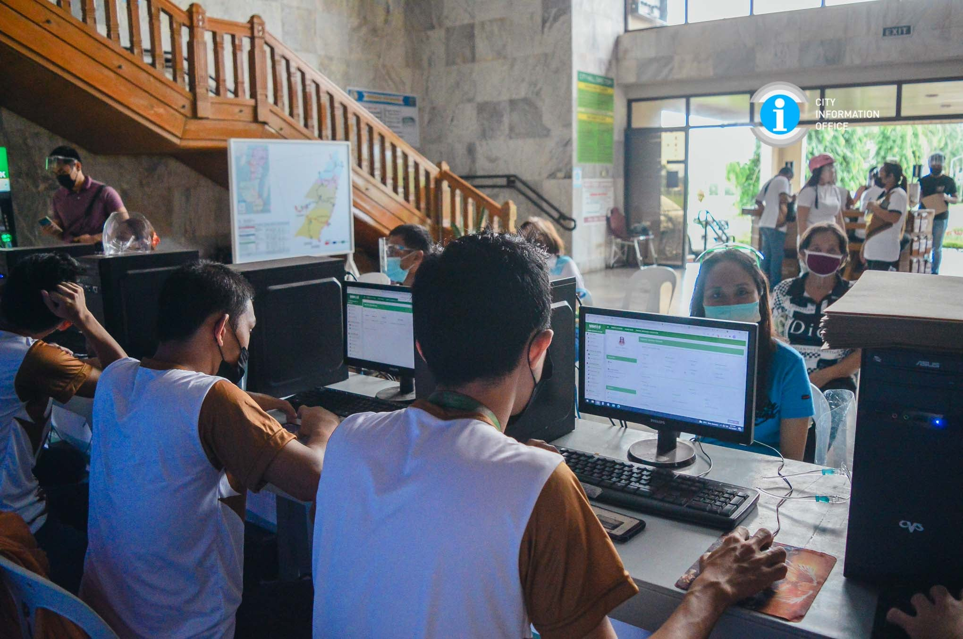

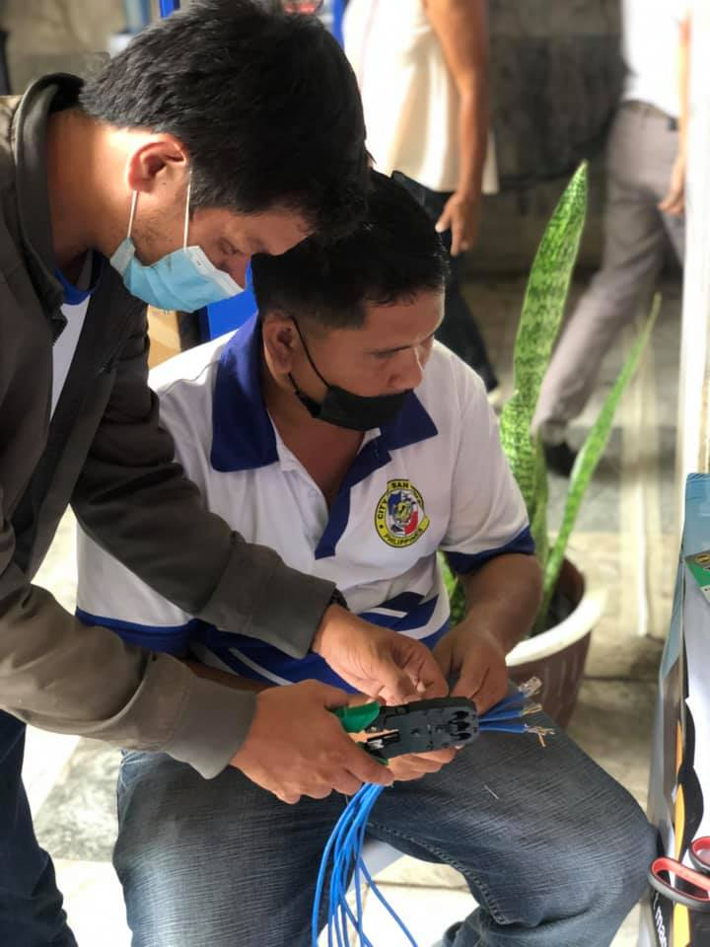
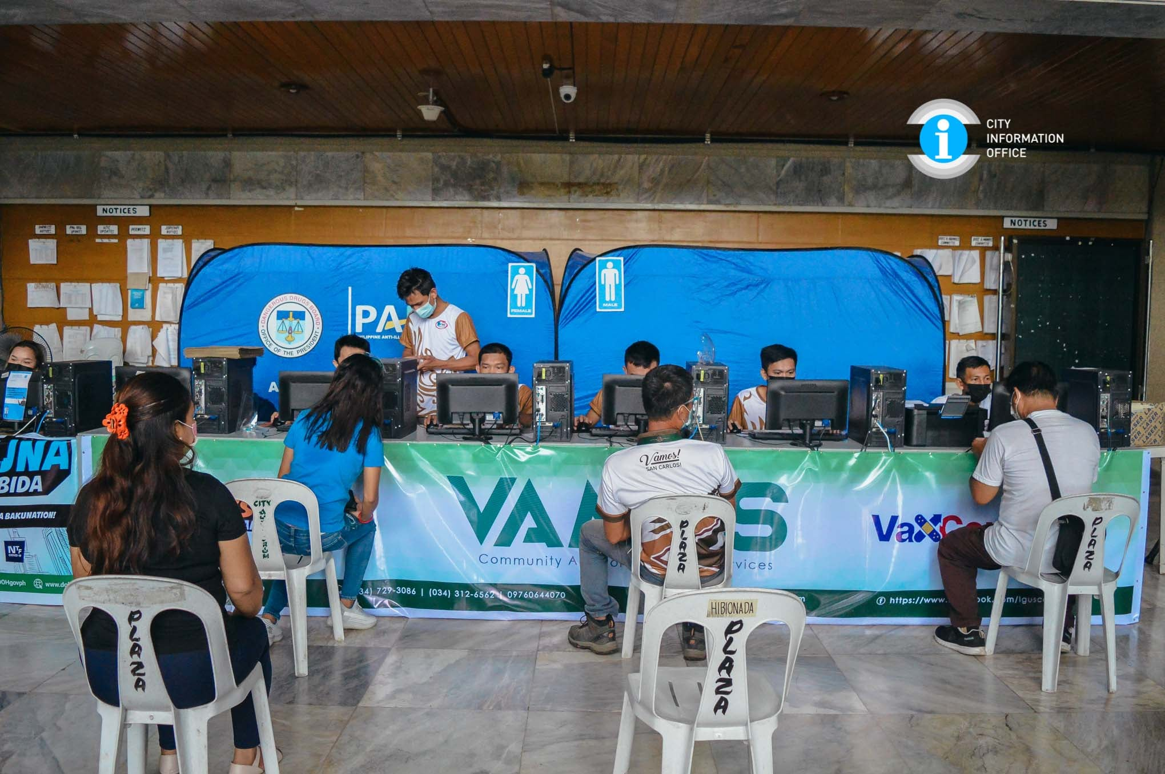

Information Technology Resources

Slide 12
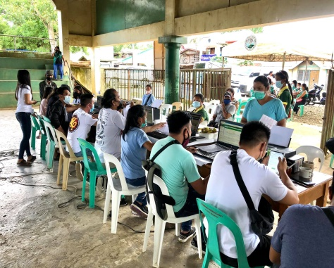
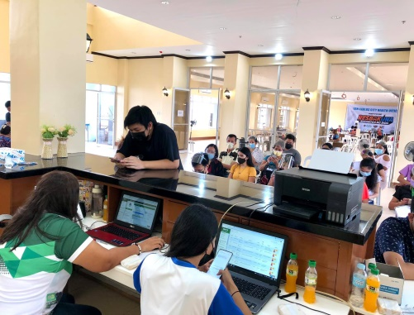
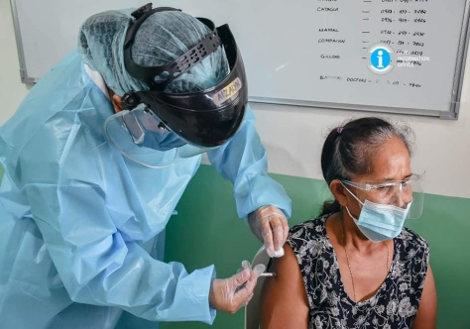
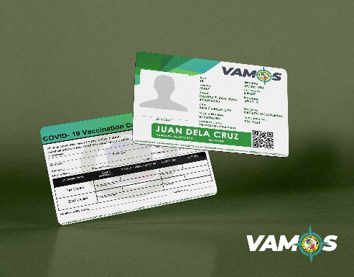
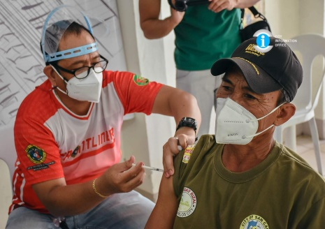
Linkage to the Vaccination/Resbakuna Program
VAMOS App is providing linkage to the Vaccination/Resbakuna Program which conforms to DOH standards
The recipients who are registered in the VAMOS App no longer need to register again online for the Resbakuna, since most of the residents have their own QR code or the VAMOS ID generated from the VAMOS App
Both the VAMOS and Resbakuna systems are integrated in a single portal used to process information through the system

Slide 13
PROJECT IMPACT

Slide 14
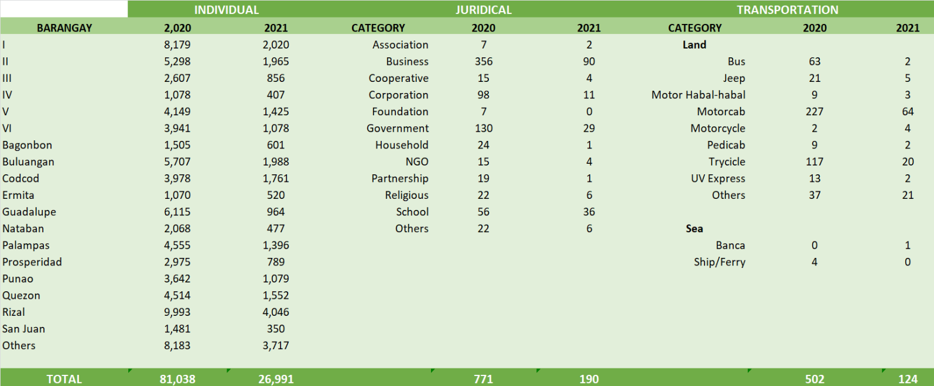
PROJECT IMPACT
There is cooperation from various establishments
Citizenry has the understanding of how the app can save them from stress, pressure and other expenses
Registered individuals including juridical and transportation sectors with corresponding QR codes have already benefited ease of access to emergency services
Individual response was impressive
VAMOS REGISTRATION RECORDS

Slide 15

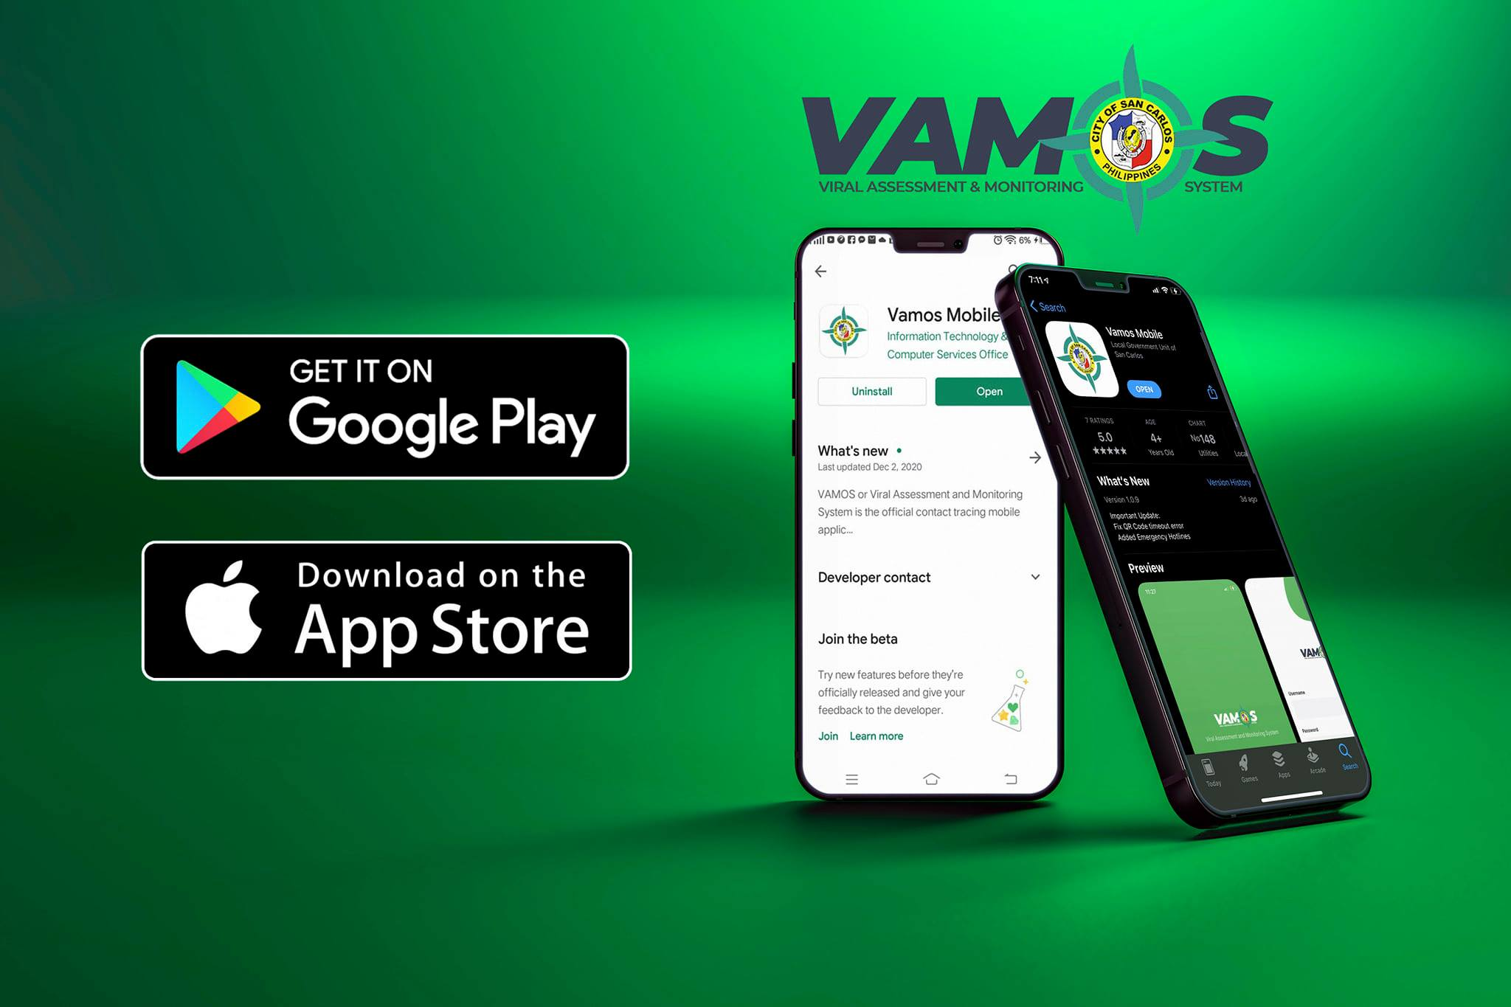
PROJECT IMPACT
ENVIRONMENT | POLITICAL | SOCIO-CULTURAL | ECONOMY
reduction of paper consumption for registration crowding en masse has been lessened wastage of consumables is decreased promotes green computing | the policies and legislations of the government enforced and regulated the use of the app and objectives are attained in the speediest way possible utilization of the app facilitated vaccine assessment and generated up-to-date and accessible reports and statistics for timely decision-making and action of the government authorities the government’s program earned the trust of its citizens as transparency has been known and shown in the transactions made | facilitates for its users not only ease of access to services but also safety from exposure to risks on health encourages communication using the app in the social and cultural spheres an initiation to a new e-lifestyle and culture Tech4Ed Program scholars-now-workers have integrated what they learned in actual work adeptly and with more comprehension. | The economy had a minimal slowdown but through the contact tracing initiative and observation of policies, the problems of spread and contamination were readily addressed and contained. most businesses remained open until now and gradually picking up from economic troubles. provided a lifesaving remedy to financial ills by way of providing employment to some of our Tech4ED Program scholars

Slide 16
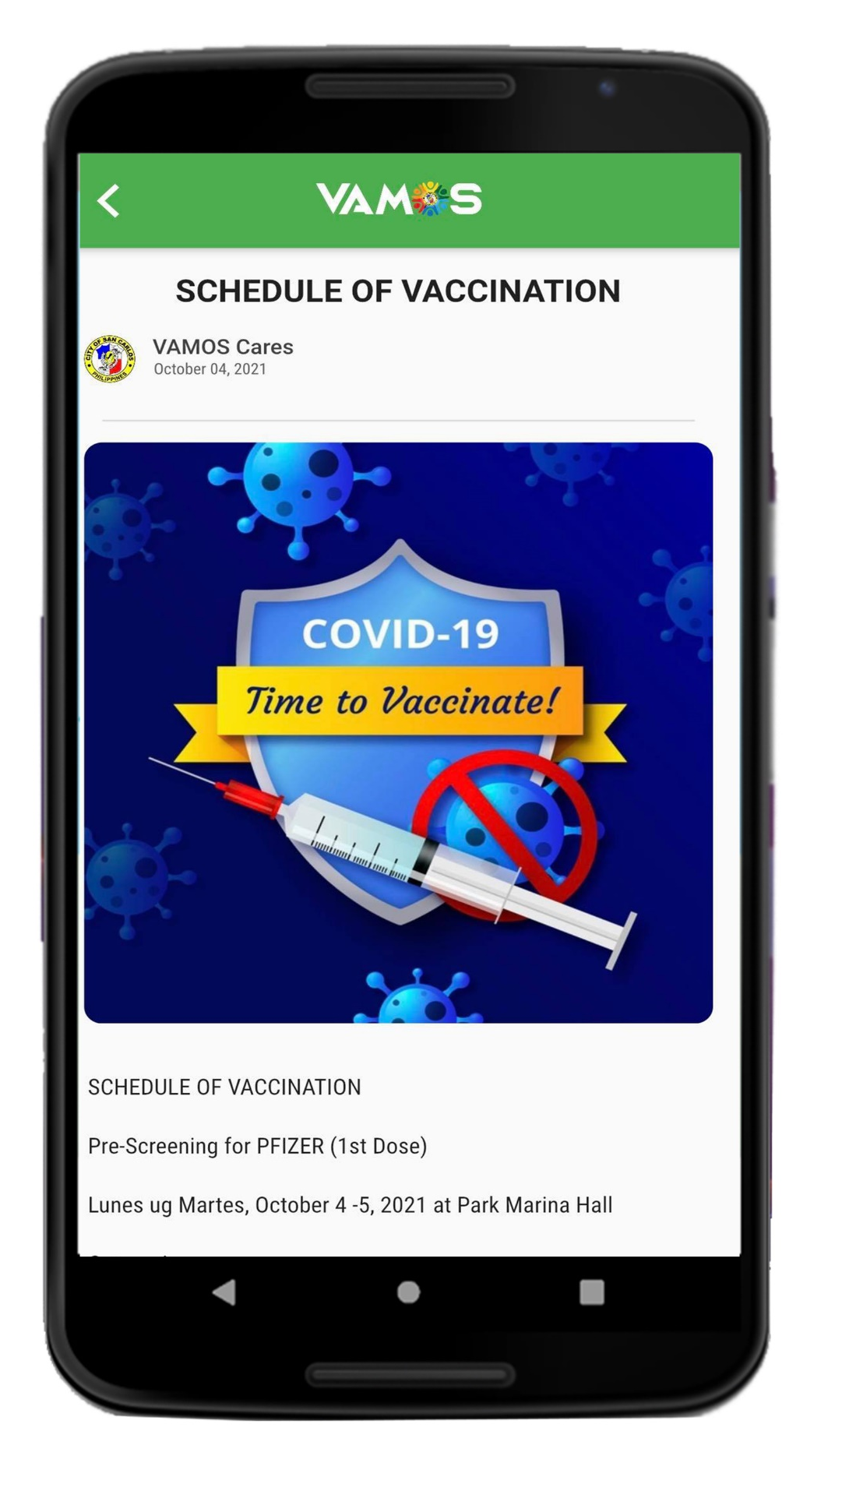
PROJECT IMPACT
Percentage of use
Registered users of the VAMOS App from the actual population of San Carlos at 135,866 (2021) is approximately 109,616, as follows:
individual - 108,029;
juridical – 961; and
transportation – 626
About 83,000 registering through the app availed of the vaccination
VAMOS App Ratings
Based on downloads and views, the following data have been generated:
3,565 downloads in IOS
20,305 downloads in Android
25,118 downloads in other devices
The users-cum-beneficiaries of the VAMOS App have shown their preference
for mobile transactions.

Slide 17
INTEROPERABILITY

Slide 18

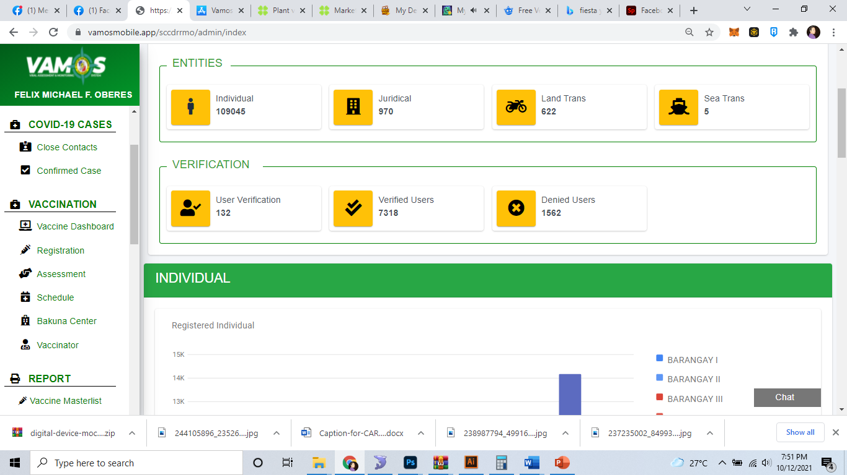
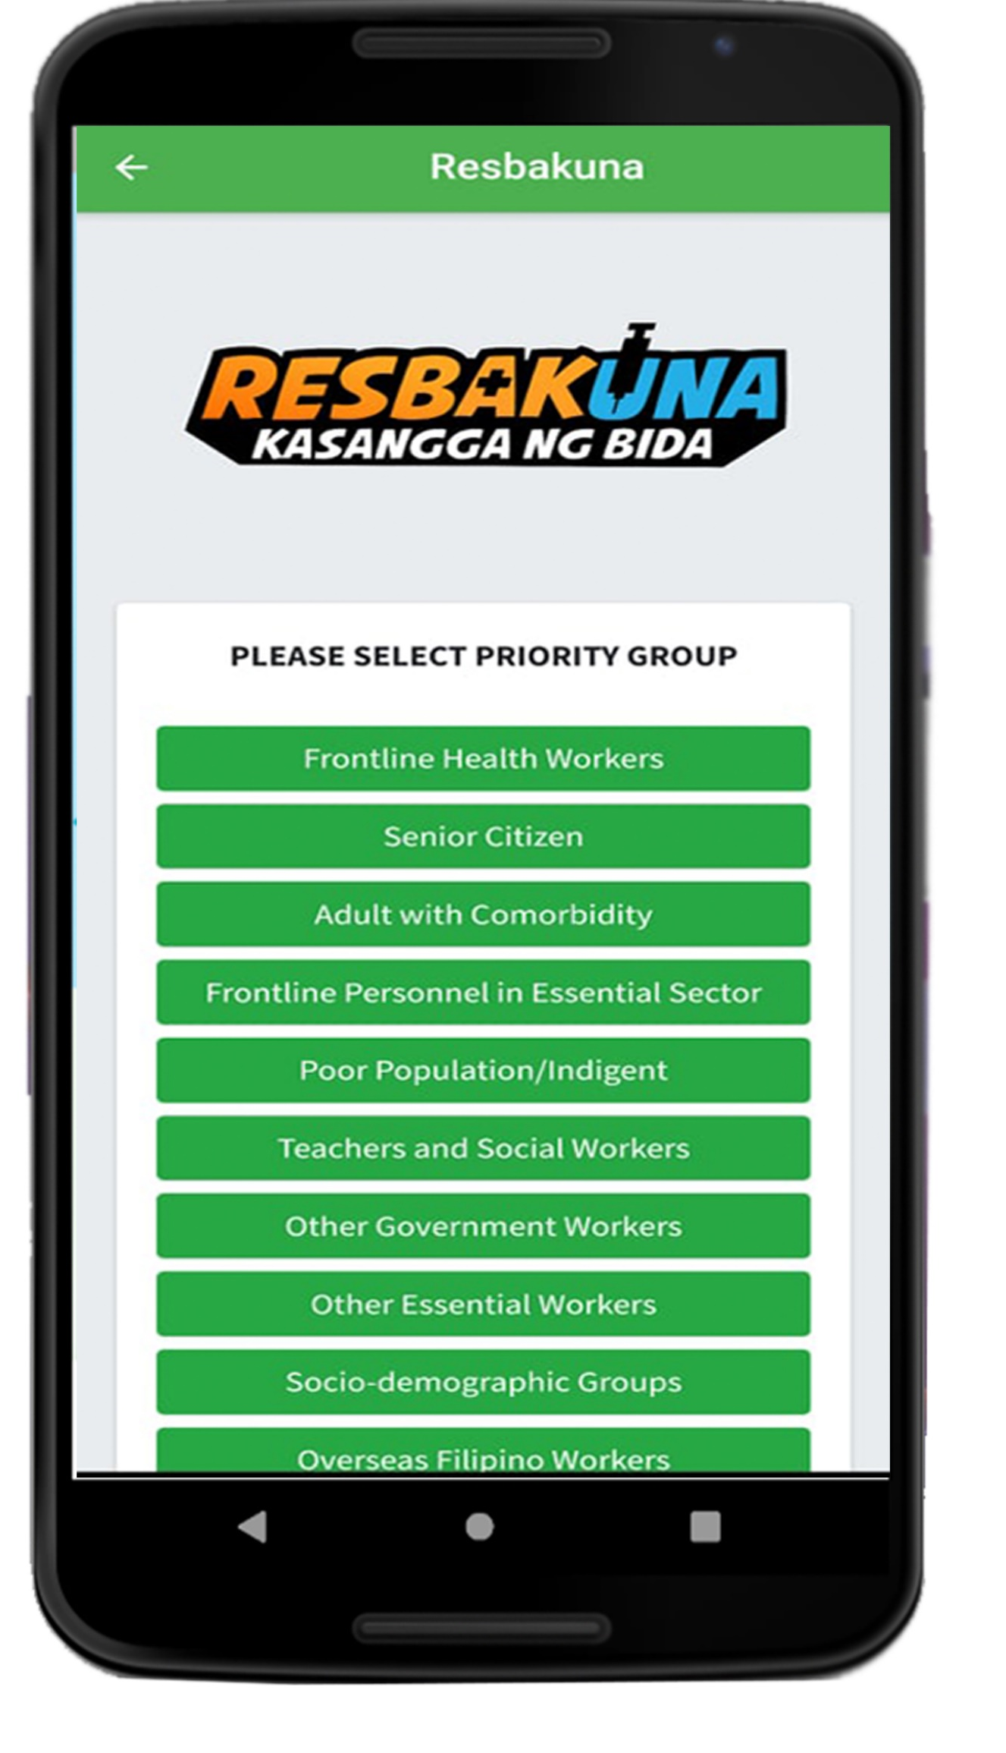
INTEROPERABILITY
VAMOS Mobile App | VAMOS Web Portal
Registration process for individual, juridical, transportation plus vaccination, scanning of QR codes, vaccine digital passport, and viewing of records | Dashboard, statistics, generation of reports, and information management
VAMOS APP - How it works

Slide 19
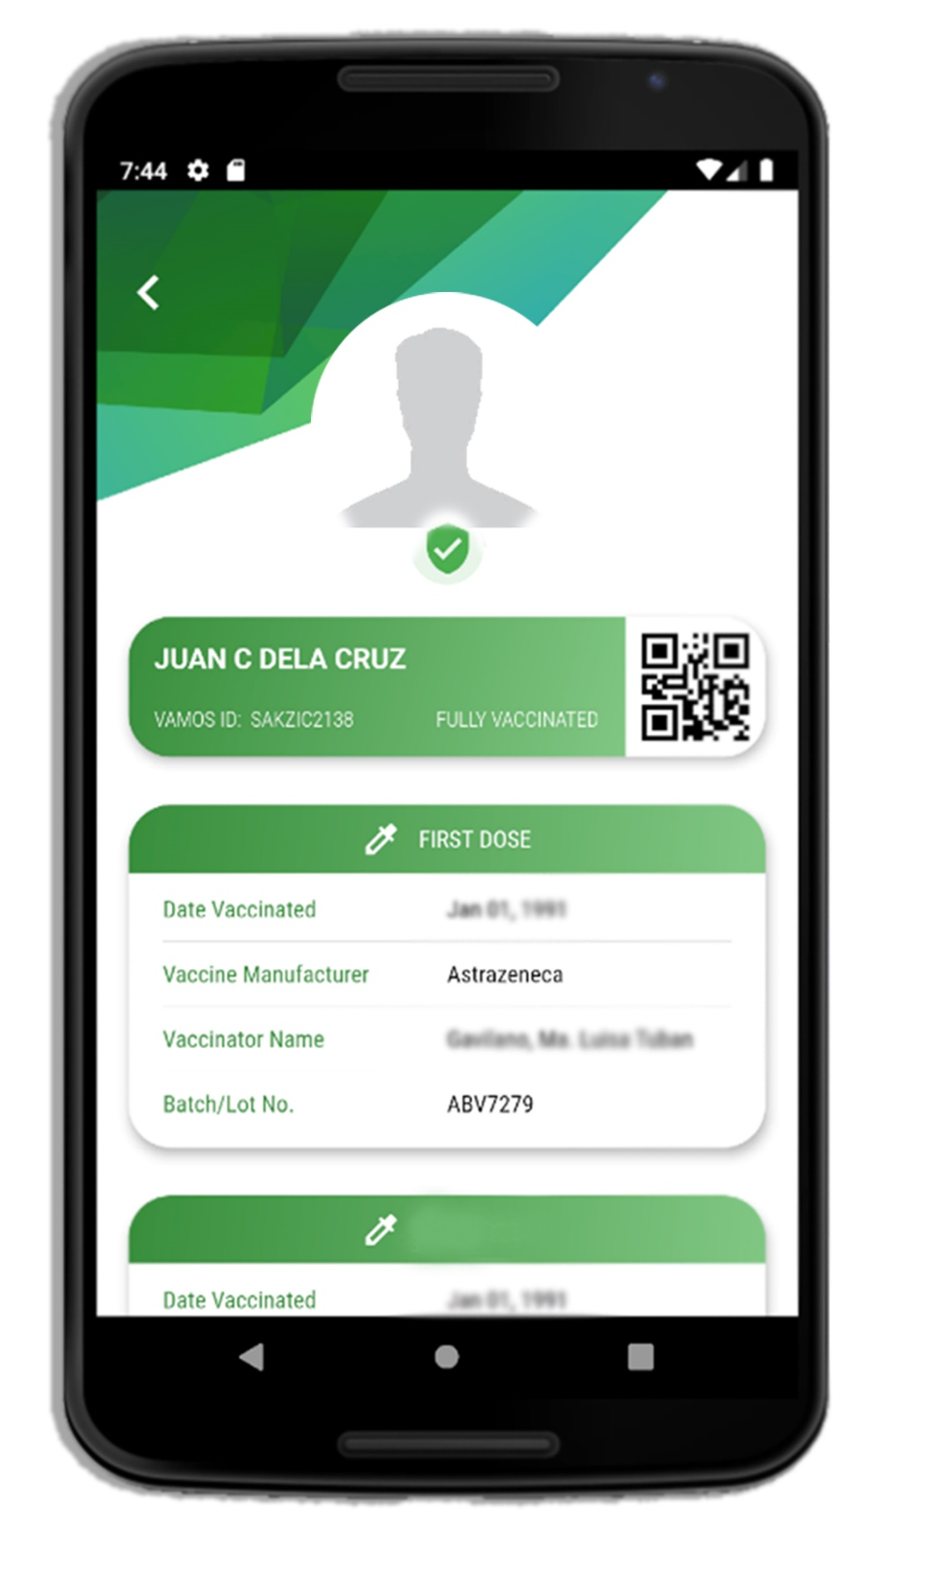
INTEROPERABILITY
Its effects and Benefits
Interoperability of the two systems is designed to boost efficiency
A centralized data bank enables the 18 barangays and other registration sites including the vaccination sites to exchange data and expedite the registration process
Full visibility and access to resident’s data for various sites and offices are the primary benefits of interoperability of the systems

Slide 20
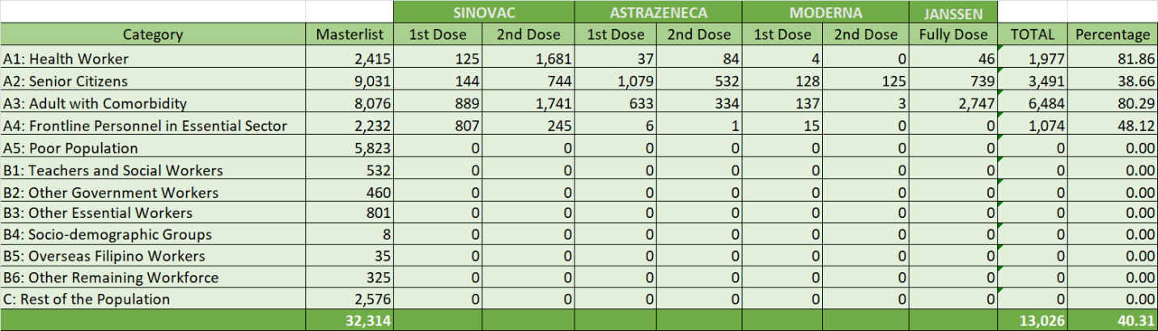
INTEROPERABILITY
Effects on the Resbakuna System
Greatly reduced turnaround time, since most of the records are already available
Registrants are given the option to register online via the Mobile App and no longer need to go to the registration centers, thus physical contact is already avoided.
The Resbakuna report of vaccinated persons has been generated and furnished immediately to local and national offices, especially the DOH.
As of to date, total registered vaccinated persons are 32,314 achieving a 40.31 percent completion rate from the masterlist.

Slide 21
COMPLIANCE TO DATA PRIVACY ACT

Slide 22

COMPLIANCE TO DATA PRIVACY ACT
Declaration of policy
It is the policy of the City Government of San Carlos to protect its residents and visitors within its territorial jurisdiction against Covid-19 through an effective and efficient implementation of the contact tracing system in accordance with Republic Act 10173 or the Data Privacy Act.
VAMOS mobile mechanism
The constituents’ whereabouts are kept tracked so as to readily assess situations and process resolutions and action on threats of the virus transmission.
VAMOS Privacy Policy
“IT IS YOUR RIGHT AS DATA SUBJECTS TO BE INFORMED ON HOW WE PROCESS YOUR PERSONAL INFORMATION”

Slide 23
COMPLIANCE TO DATA PRIVACY ACT
Privacy notice
VAMOS platform collects personal and sensitive personal information to ensure proper selection, management and deployment of staff
FOR INDIVIDUAL |  | FOR JURIDICAL |  | FOR TRANSPORTATION
INFORMATION TITLE | TYPE OF PERSONAL INFORMATION | INFORMATION TITLE | TYPE OF PERSONAL INFORMATION | INFORMATION TITLE | TYPE OF PERSONAL INFORMATION
Username | Sensitive Personal Information | Username | Sensitive Personal Information | Username | Sensitive Personal Information
Password | Sensitive Personal Information | Password | Sensitive Personal Information | Password | Sensitive Personal Information
First Name | Regular Personal Information | Organization Name | Regular Personal Information | Land Transportation Type | Regular Personal Information
Middle Name Initial | Regular Personal Information | Organization Type | Regular Personal Information | Vehicle Name | Regular Personal Information
Last Name | Regular Personal Information | Business Nature | Regular Personal Information | Vehicle Number | Regular Personal Information
Mobile Number | Sensitive Personal Information | Street | Regular Personal Information | Route | Regular Personal Information
Telephone Number (Optional) | Sensitive Personal Information | Barangay | Regular Personal Information | Plate Number | Sensitive Personal Information
Email Address | Sensitive Personal Information | City | Regular Personal Information | Vessel Name | Regular Personal Information
Gender | Sensitive Personal Information | Province | Regular Personal Information | Voyage Number | Sensitive Personal Information
Birthdate | Regular Personal Information | Contact Name | Regular Personal Information | Port Embarkation | Regular Personal Information
Street | Regular Personal Information | Contact Name’s Position | Regular Personal Information | Contact Name | Regular Personal Information
Barangay | Regular Personal Information | Mobile Number | Sensitive Personal Information | Contact Name’s Position | Regular Personal Information
City | Regular Personal Information | Telephone Number | Sensitive Personal Information | Mobile Number | Sensitive Personal Information
Province | Regular Personal Information | Email Address | Sensitive Personal Information | Telephone Number | Sensitive Personal Information
Photo | Sensitive Personal Information | Photo | Sensitive Personal Information | Email Address | Sensitive Personal Information
 |  |  |  | Photo | Sensitive Personal Information
All personal and sensitive information about you will be destroyed along with its erasure from the database, or in line with either the individuals upon ITCSO decision. All personal and sensitive information processed by the ITCSO and authorized personal information processors shall be kept under strict confidentiality for the entire period of retention.

Slide 24
THE FUTURE OF VAMOS CARES

Slide 25
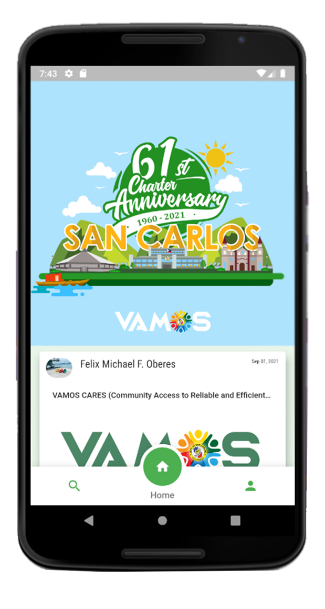
The Future of VAMOS App as C.A.R.E.S.:
(Community Access to Reliable e-Services)
VAMOS gave host to more than just contact tracing but other uses and service features such as news and announcements, emergency response, law enforcement, utility bills and payments, business permits and taxes, e-tickets, document tracking, events and reservations, tourism and marketing and many more exciting features making it an integral part of the life of its citizens and government, in particular.

Slide 26


THANK YOU!!!

